Slide 1
Data Flow Diagrams

Slide 2
Data Flow Modeling
Widely used; focuses on functions performed in the system
Views a system as a network of data transforms through which the data flows
Uses data flow diagrams (DFDs) and functional decomposition in modeling

Slide 3
Data flow diagrams
A DFD shows flow of data through the system
Views system as transforming inputs to outputs
Transformation done through transforms
DFD captures how transformation occurs from input to output as data moves through the transforms
Not limited to software

Slide 4
Data flow diagrams…
DFD
Transforms represented by named circles/bubbles
Bubbles connected by arrows on which named data travels
A rectangle represents a source or sink and is originator/consumer of data (often outside the system)

Slide 5
DFD Conventions
External files shown as labeled straight lines
Need for multiple data flows by a process represented by * (means and)
OR relationship represented by +
All processes and arrows should be named
Processes should represent transforms, arrows should represent some data

Slide 6
Data flow diagrams…
Focus on what transforms happen , how they are done is not important
Usually major inputs/outputs shown, minor are ignored in this modeling
No loops , conditional thinking , …
DFD is NOT a control chart, no algorithmic design/thinking
Sink/Source , external files

Slide 7
Drawing a DFD for a system
Identify inputs, outputs, sources, sinks for the system
Work your way consistently from inputs to outputs, and identify a few high-level transforms to capture full transformation
When high-level transforms defined, then refine each transform with more detailed transformations

Slide 8
Drawing a DFD for a system..
Never show control logic
Label each arrows and bubbles; carefully identify inputs and outputs of each transform
Make use of + & *
Try drawing alternate DFDs

Slide 9
Leveled DFDs
DFD of a system may be very large
Can organize it hierarchically
Start with a top level DFD with a few bubbles
then draw DFD for each bubble
Preserve I/O when “ exploding” a bubble so consistency preserved
Makes drawing the leveled DFD a top-down refinement process, and allows modeling of large and complex systems

Slide 10
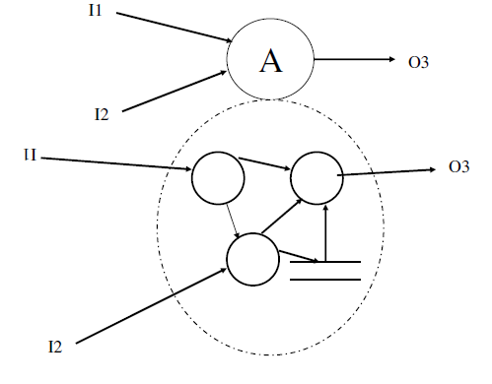
Leveled DFDs

Slide 11
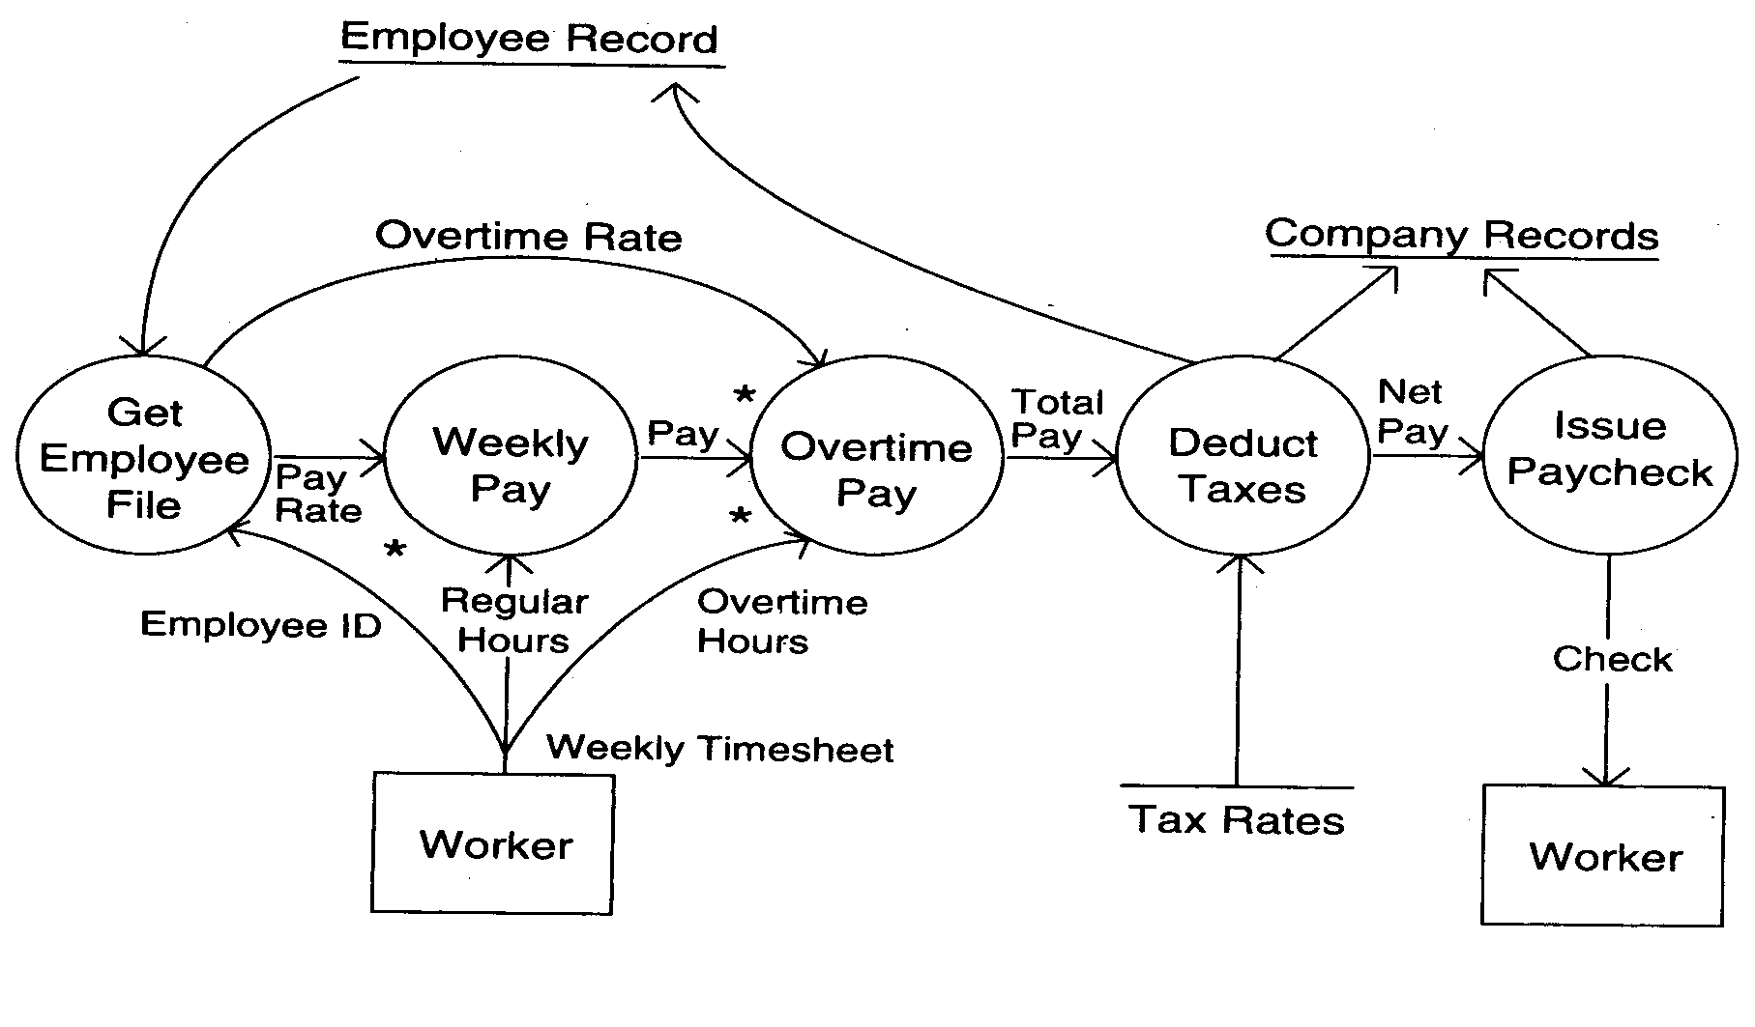
DFD Example

Slide 12
Data Dictionary
In a DFD arrows are labeled with data items
Data dictionary defines data flows in a DFD
Shows structure of data; structure becomes more visible when exploding
Can use regular expressions to express the structure of data

Slide 13
Data Dictionary
Notation | Meaning
x= a+b | x consists of data element a & b
x={a/b} | x consists of either a or b
x=(a) | x consists of an optional data element a
x= y{a} | x consists of y or more occurrences of a
x={a}z | x consists of z or fewer occurrences of a
x=y{a}z | x consists of between y & z occurrences of a

Slide 14
DFD Example Book Ordering System

Slide 15
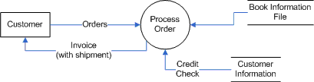
Level 0 (Context Diagram)

Slide 16
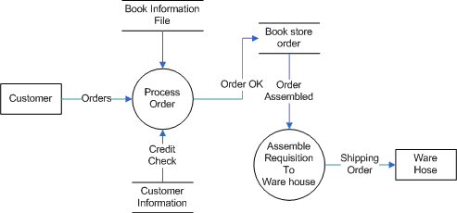
Level 1

Slide 17
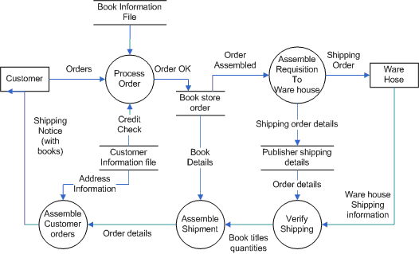
Level 2

Slide 18
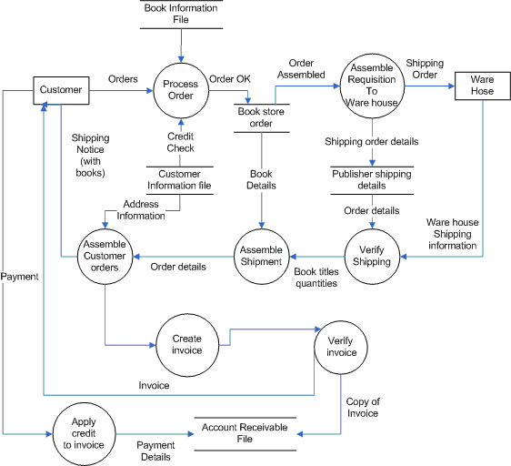
Level 3

